Slide 1
Quality and safety of milk in Nairobi: Evidence and Potential Solutions at
Milk quality and safety seminar:
‘Fostering safe milk practices for a competitive Kenyan dairy sector’ on
29th January 2019 at
Venue: Azure Hotel, Westlands, Nairobi by
G. Wanjala, BSc, MSc, FSPHT
Research Scientist , KIRDI
Tell: +254-722 697382, Email: wafulageo@gmail.com, wafulageo@yahoo.co.uk

Slide 2
Outline
Brief introduction of KIRDI
Introduction – quality and safe milk
Research design and approach
Quality of raw milk in Nairobi metropolis
Challenges in milk production, handling and processing
Successful approaches – dairy sector
Current research and opportunities for partnership
Conclusion

Slide 3
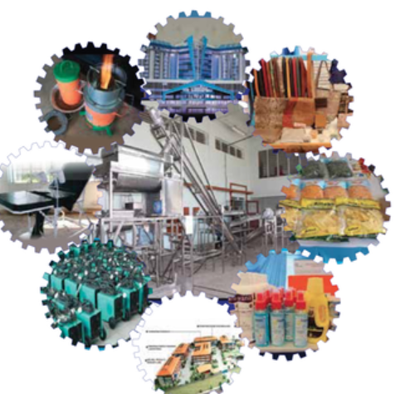
Brief introduction of KIRDI
Kenya’s Industrial Research and Development Institute
Technology Transfer and Extension Services (TTES)
Research Technology and Innovation (RTI) Department
Engineering (Chemical, Mechanical, Electrical)
Leather and Textile Technologies
Ceramics and building materials
Energy
ICT
Food Tech
Your industrial technology partner (www.kirdi.go.ke)

Slide 4
Introduction – quality and safe milk
Raw milk from udder of healthy, well fed animal is virtually sterile.
Poor hygiene & bad husbandry expose cows to infections – antibiotics. ‘‘Healthy cows don’t need antibiotics”
Antimicrobial resistance is a global threat - public health, food safety, food security, and livelihoods.
Yearly, 0.7M people die - antimicrobial resistant (AMR) infections (FAO, 2018). How many people in Kenyan? How many dairy cows are not responding to treatment?
Quality of feeds – nutrition balance, dry matter, absence from contaminants – heavy metals, aflatoxins impacts on milk safety.

Slide 5
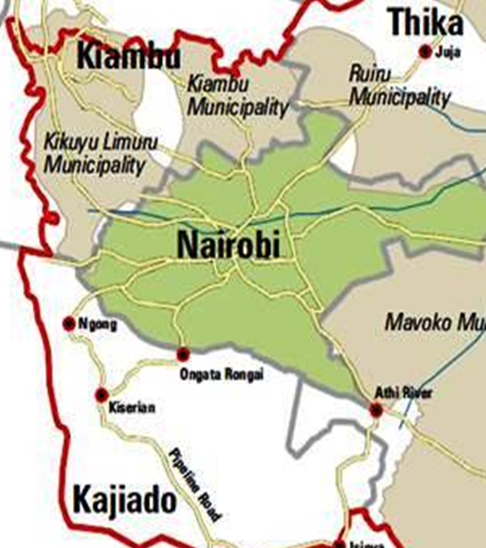
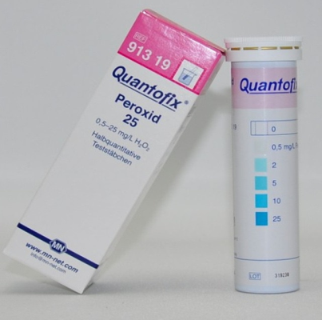
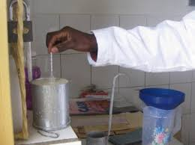

Research design and approach
Quality and safety analysis - milk supply chain
Stratified random sampling:
Milk production and consumption areas in Nairobi Metropolis
Rural – Kiambu/Ngong, Urban – CBD, Slums – Kibera/Mathare
Evaluation criteria
KS raw milk
KS Code of Hygienic Practice for Milk and Milk Products

Slide 7
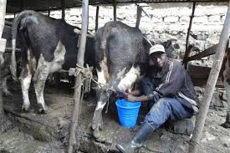
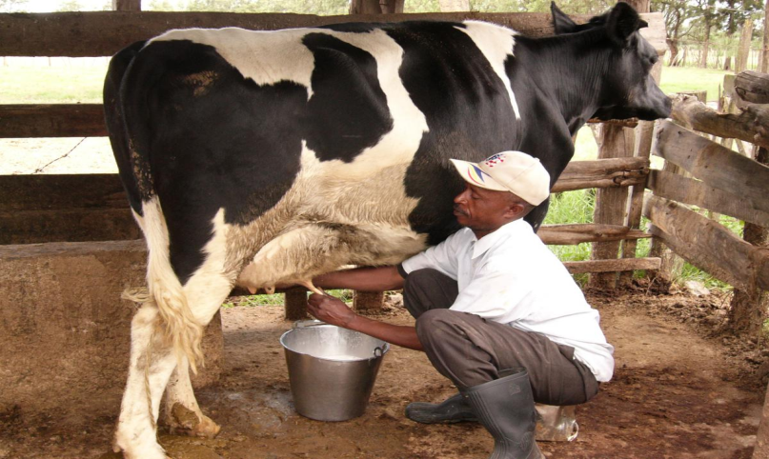
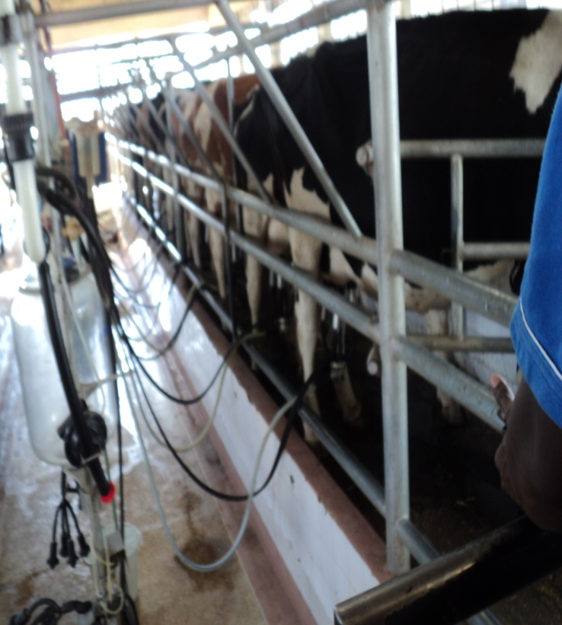
Challenges in milk production
Bulking milk of different microbial qualities
Environmental hygiene
Mastitis infection
High antimicrobial use
High microbial contamination ……Listeria, E.coli, Campylobacter, Streptococci?
Raw milk

Slide 8
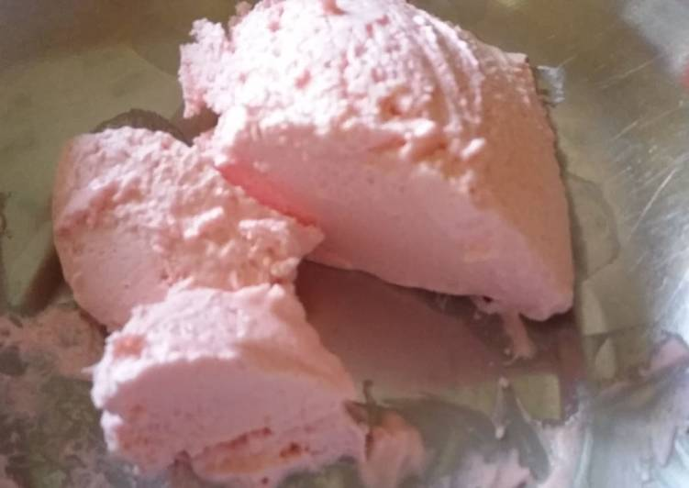
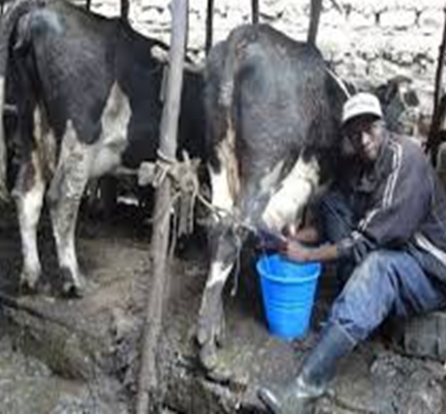
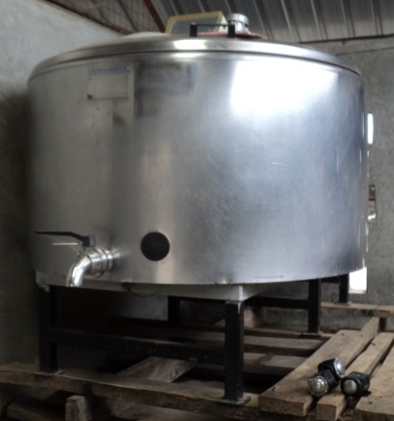
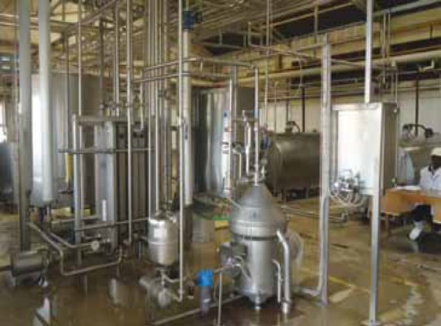
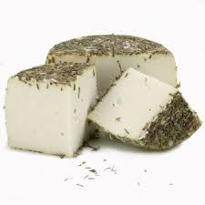
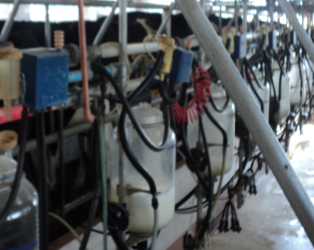
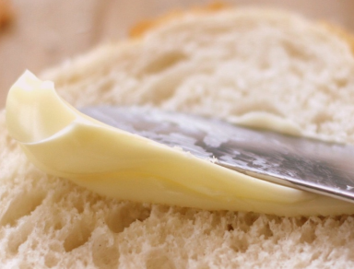
Microbial quality threat - handling and processing milk products
Listeria monocytogenes - Fatal pathogen.
Environment, colonizes the food process environment-
biofilms - elderly, pregnant, children, low immunity
S
Campylobacter jejuni, E. coli 0157, Zoonotic diseases
Risk assessment by Kenyan Dairy Industry?

Slide 9
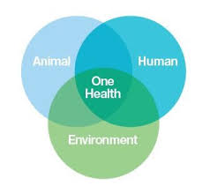
Successful approaches - dairy sector
One health concept – advocated by FAO/WHO (FAO, 2018).
How is ‘One health approach’ implemented in Kenya?
Promote synergy – environmental health, animal health & human health

Slide 10
Antimicrobial residues and hygiene
To stay ahead of AMR - prioritize infection prevention, responsible use of antimicrobials - who treats, disease diagnosis, therapy?
Danish reduce use of antibiotics - regulatory authority (monitor use of antibiotics), farmers practice high level of hygiene and cleanliness - who milks in Kenya?
UK - national guidelines for prescribing and use antimicrobials.
UK - focus on HACCP, GMP - hygiene and handling practices (use of gloves, udder health) at milking parlour, stables - SCC and mastitis in production systems.

Slide 11
Feeding practices
Feed quality and safety - aflatoxin prevention and early detection by feed manufacturers and dairy farms, quick analytical kits & laboratory service.
Focus on fodder development and production; new grasses/hybrid grasses that are nutritious but climate smart
Research - milk from grass-fed cows was higher in omega-3 and conjugated linoleic acid than milk from grain based diet.
Consuming more omega-6 and little omega-3 can increase the risk of cardiovascular disease, obesity, and diabetes.
Grass and legume based diet improves fatty acid profile ratio of omega-6:omega-3 from the normal 5.7:1 to almost 1:1.

Slide 12
Current research and opportunities for partnership
Adaptation and promotion of refractance window drying technology (BioInnovate II 2018-2021).
Quality improvement of raw milk profile through introduction and promotion climate smart grass hybrids.
Fruit and vegetable bye products in formulation of animal feeds.
One health; AMR infections & risk assessment for L. monocytogenes, Campylobacter jejuni, E. coli, & brucellosis in Kenya.
Quality and safe milk enhancement through establishment and promotion of reference testing services for animal feeds and milk.
Study to understand drivers and determinants for adoption of quality improvement in dairy.

Slide 13
Conclusion
Do we know conclusively, the magnitude of antimicrobial use and resistance in Kenya? Who monitors and documents food safety incidences, food fraud in Kenya? Etiology of food related deaths? What is investigated and conclusively reported? There is need for investment in surveillance and research to measure progress towards AMR mitigation. The dairy sector needs to develop frameworks that work in line with “one health approach” to prevent, monitor and manage food safety along the dairy value chain.

Slide 14
References
‘Enhancing the Fatty Acid Profile of Milk through Forage-Based Rations, with Nutrition Modeling of Dietary Outcomes’, Food Science and Nutrition journal.
FAO, 2018
Wanjala, et al., 2018. Prevalence of Adulteration and Inhibitory Substances in Raw and Pasteurized Milk Marketed in Nairobi Region. AFSJ, 3(2): 1-8, 2018.
Wanjala, et al., 2017. “Microbiological Quality and Safety of Raw and Pasteurized Milk Marketed in and around Nairobi region. AJFAND 17(1):11518-11532.

Slide 15


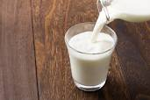
 | KIRDI
Your Industrial Technology Partner
Thank you

