Slide 1

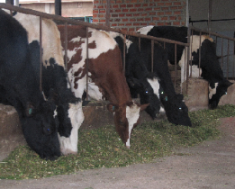
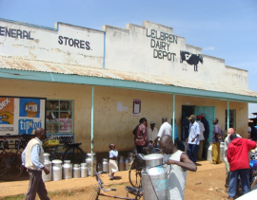
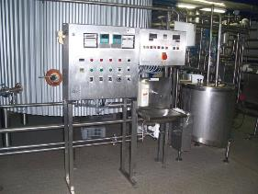
SNV KENYA
Embassy of the Kingdom of the Kingdom of the Netherlands
Kenya Market-led Dairy Programme

Slide 2

Kenya Market-led Dairy Programme
(KMDP)
Funded by the Embassy of the Kingdom of the Netherlands in Kenya
Implemented by SNV Kenya and stakeholders in Kenya and The Netherlands
KMDP-I : July 1st 2012 – December 31st 2016
KMDP-II: 1st October 2016 – 30th June 2019
Regions: Central, Eastern and North Rift

Slide 3

PUM / NETHERLANDS SENIOR EXPERTS
Funded by the Dutch Ministry of Foreign Affairs
Active in 70 countries with 265 local representatives
Technical support to SMEs in agriculture and non-agricultural economic sectors with focus on SMEs
A pool of 2,500 voluntary experts of 55+ years
Collaboration with SNV KMDP

Slide 4

Perfometer Agribusiness Ltd
A local dairy advisory firm with … staff
Dairy farm benchmarking, planning and advisory
Total farm management incl. fodder and feed rationing
Dairy Investors Platform
Academy of Dairy Farm Managers
Collaboration with SNV KMDP and PUM

Slide 5
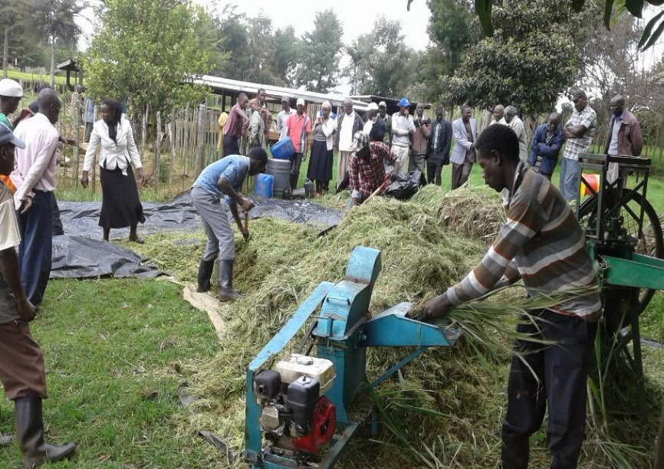
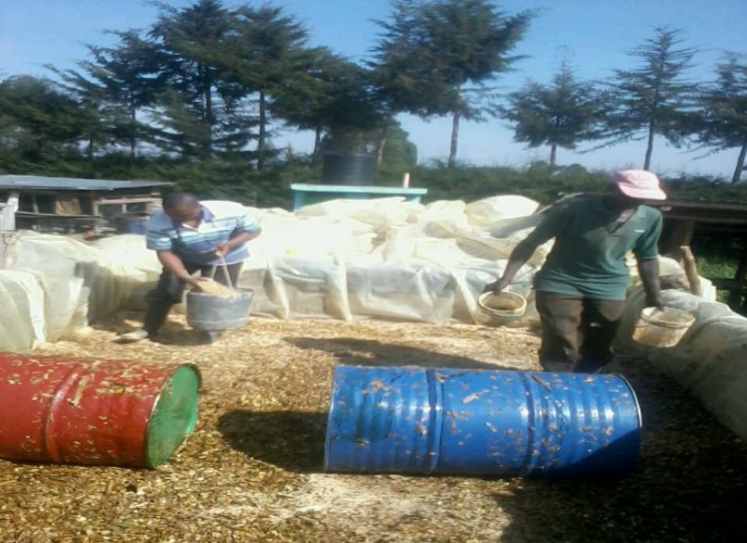
Smallholder Dairy Cooperatives (19)

Slide 6
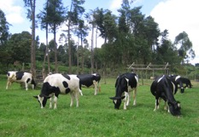
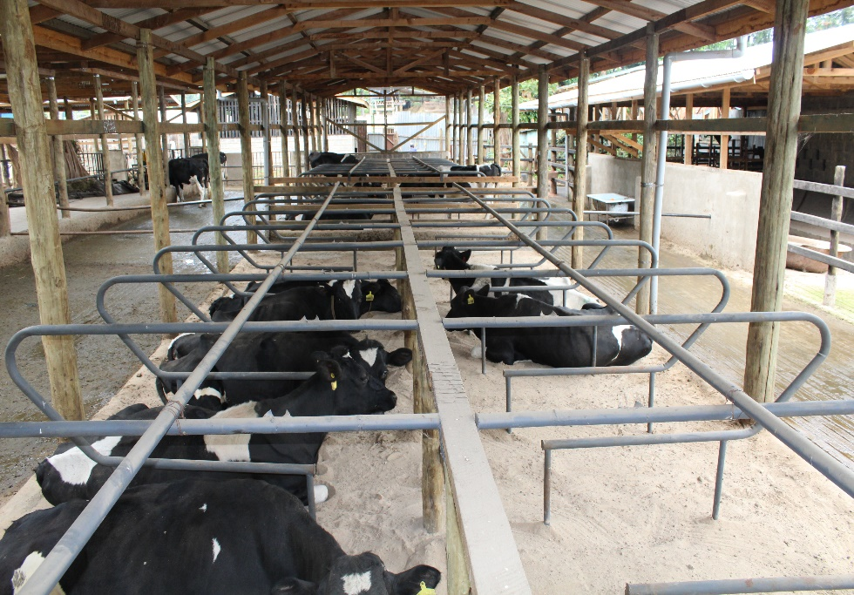
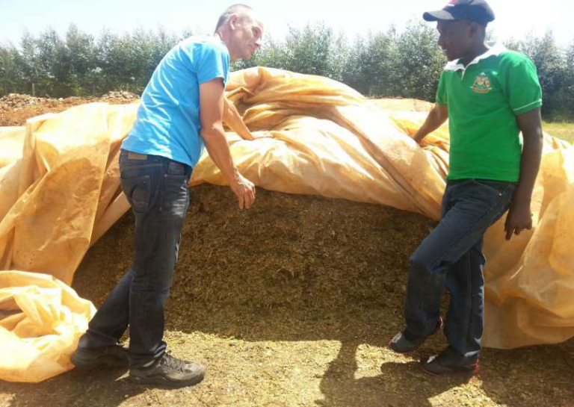
Medium Scale Farmers

Slide 7
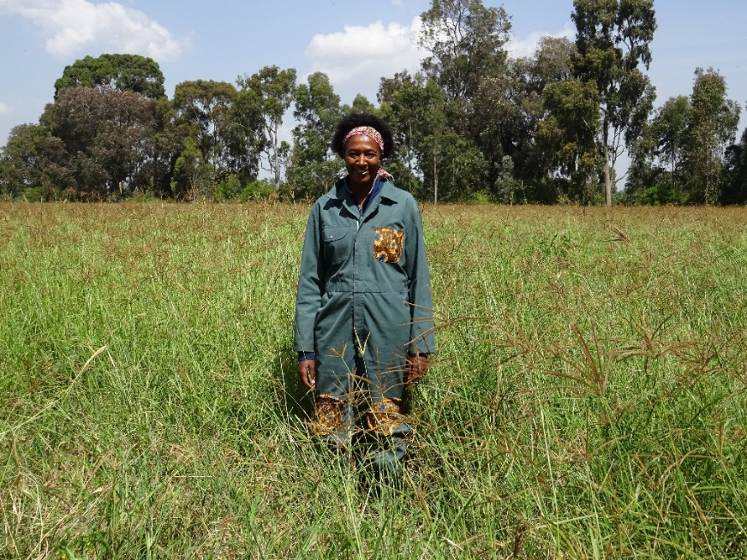
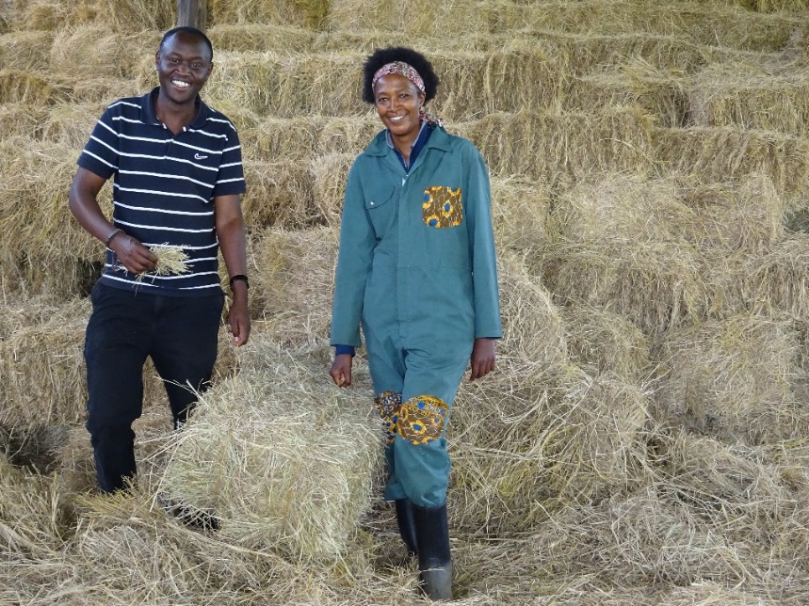
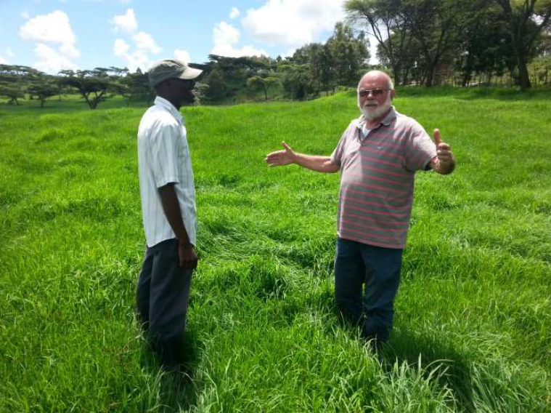
Commercial Fodder Producers

Slide 8
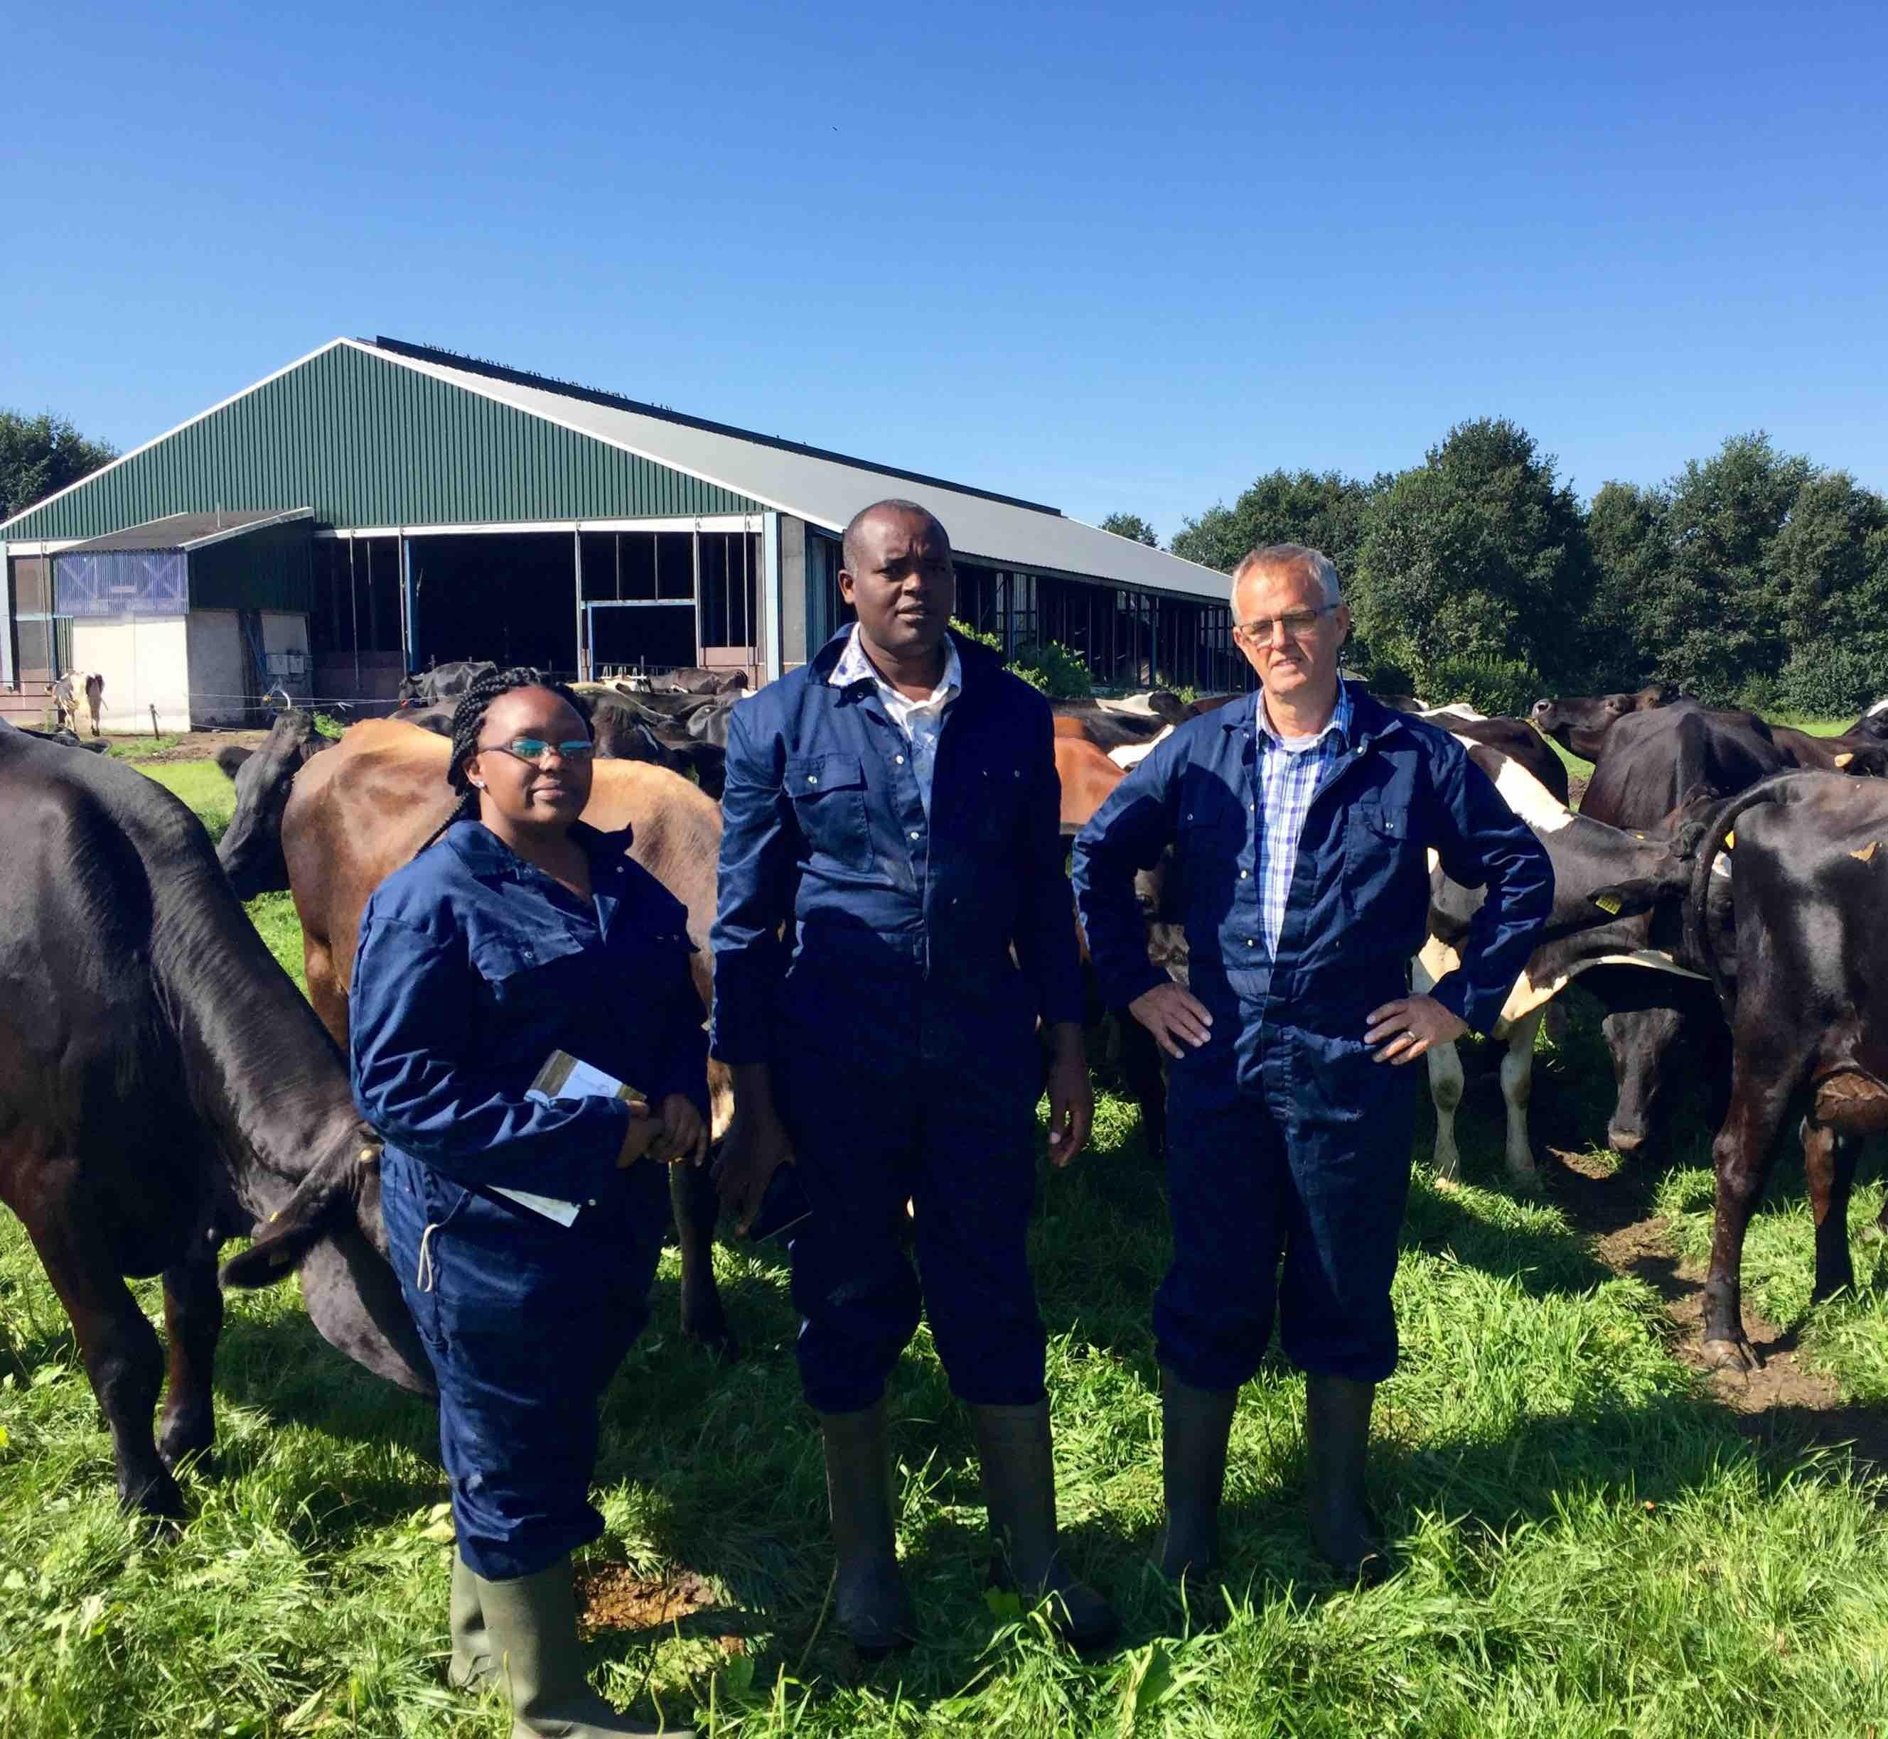
Knowledge Exchange
Dairy Development has no Boundaries

