Slide 1
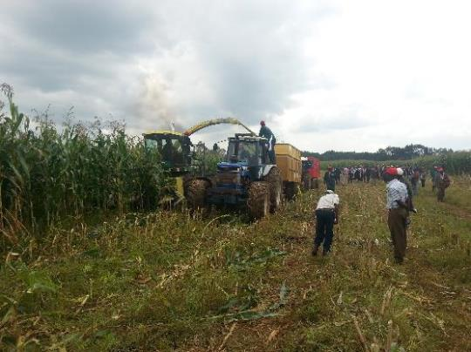
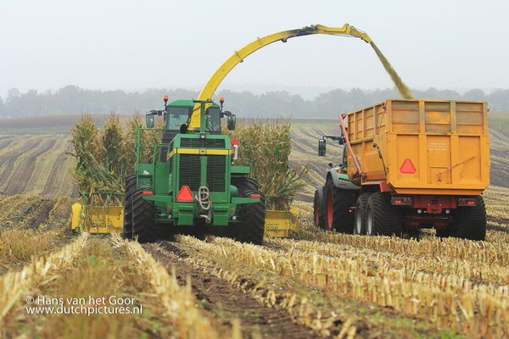
MAIZE AND GRASS TRAIN
AGRICULTURAL MACHINERY CONTRACTING- DEJIRENE AND NUNDOROTO

Slide 2
Nundoroto
Agricultural Contracting Services - Maize Train
Company:
Nundoroto Farm Company Ltd (Uasin Gishu)
Established in 2007 by Reverend Evert Van Den Ham
Agr. contracting services to large, medium and small scale dairy farmers
Machinery:
- 6 Tractors - Tipping trailers
- Maize planters - Disc ploughs
- Chisel ploughs - Mouldboard ploughs
- Harrows - Boom sprayers
- Fertilizer applicators - Forage harvesters
- Shovels - Maize shelling
Latest machine: 6-row John Deer harvester (6850)

Slide 3
Services offered:
Land preparation (mould board ploughing, harrowing)
Planting (precision planting)
Fertilization (soil analysis, fertilizer spreading)
Crop management (boom spraying)
Combiner harvesting cereals
Forage harvesting and preservation (hay, maize and grass silage)
Post harvesting (shredding and manure application)
Seed agents (better seeds with better planting machines)
Professional advisory services
In future: agency for seeds and fertilizers

Slide 4
Dejirene Ltd
Services offered:
Dealers in used farm machinery and equipment
Agricultural contracting services (grass and maize train)
Land preparation and sowing
Maize and grass silage harvesting
Dejirene Ltd collaborates with Nundoroto in the implementation of the “Maize and Grass Train Concepts”

Slide 5
MAIZE TRAIN CONCEPT
The “Maize Train” is a chain of farm machinery, processes and logistics providing a one-stop fodder solution to dairy farmers from “seed to feed”:
Land preparation, fertilization, seeding and spraying
Harvesting, chopping and kernel crushing
Quick transport facilities from field to pit or clam
Proper pit dimensions, compression and airtight coverage

Slide 6
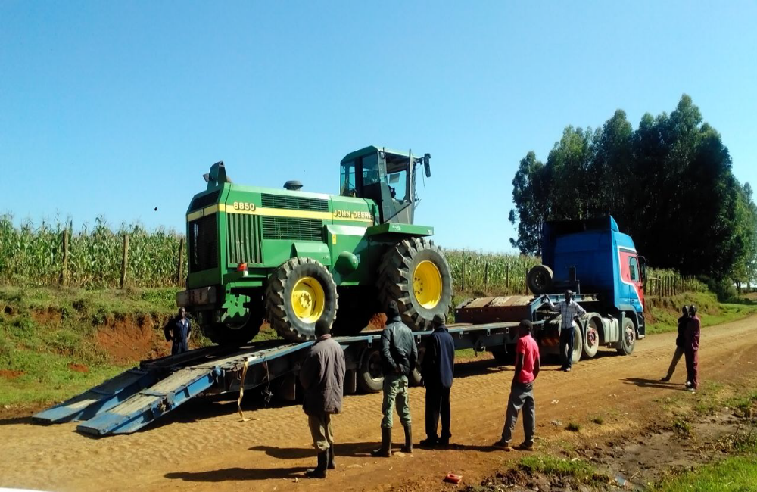

Slide 7
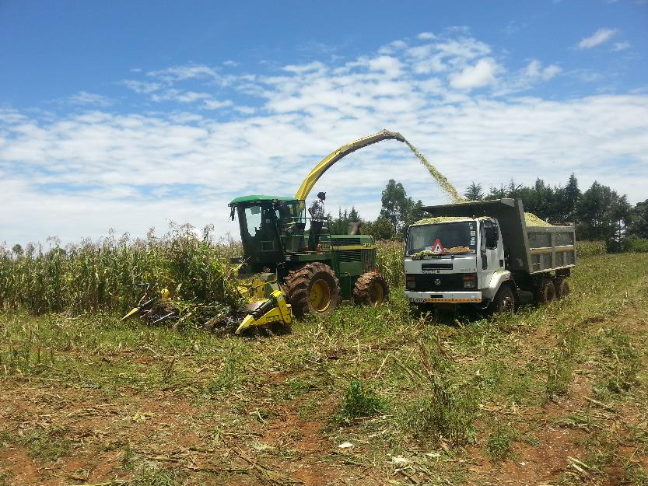
Chopping

Slide 8
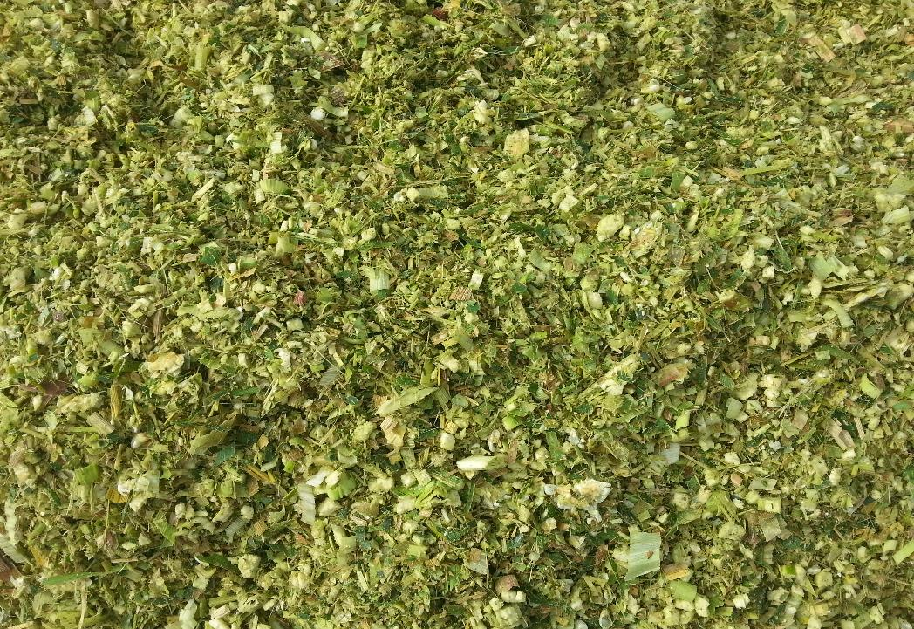

Slide 9
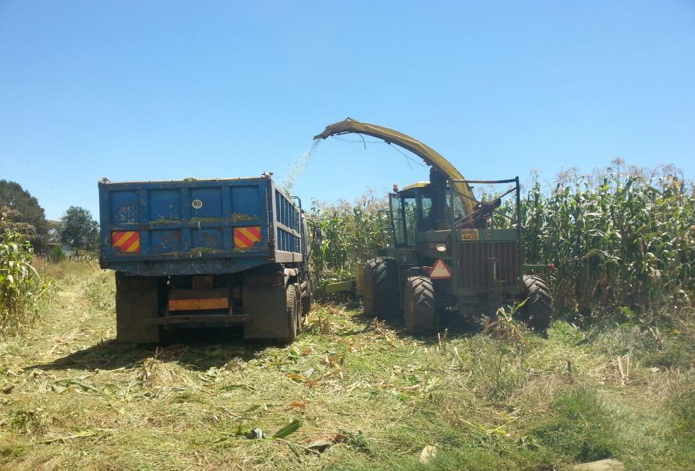
Transport - Tipping Trucks

Slide 10
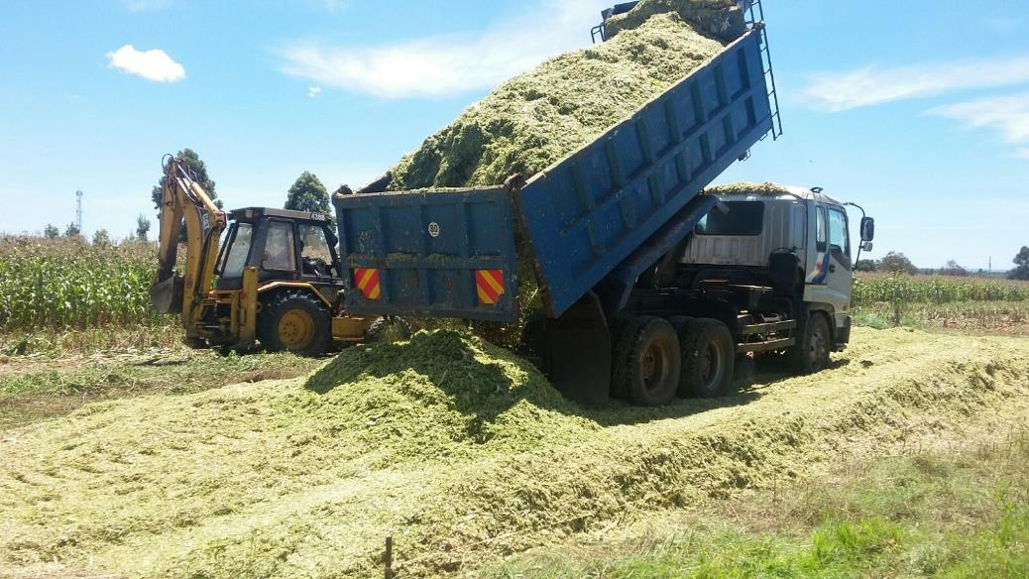

Slide 11
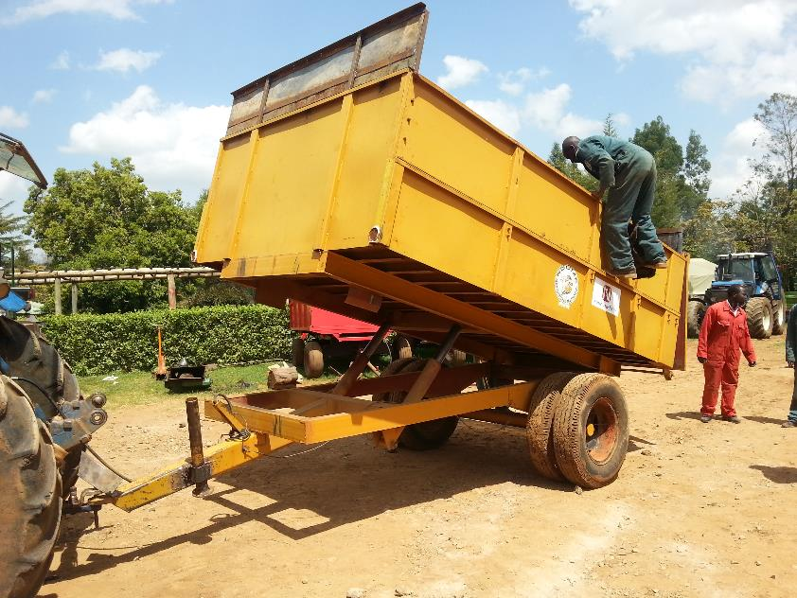
Tractor pulled tipping trailers/wagons

Slide 12
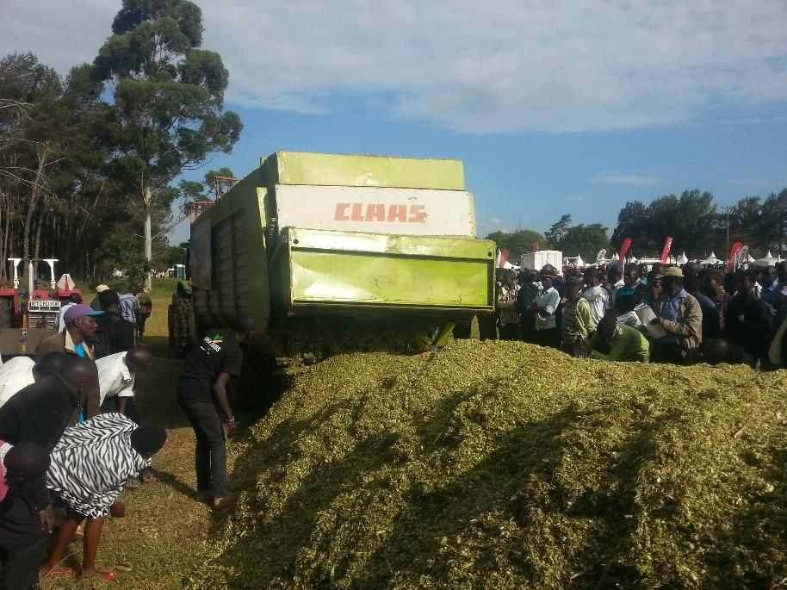

Slide 13
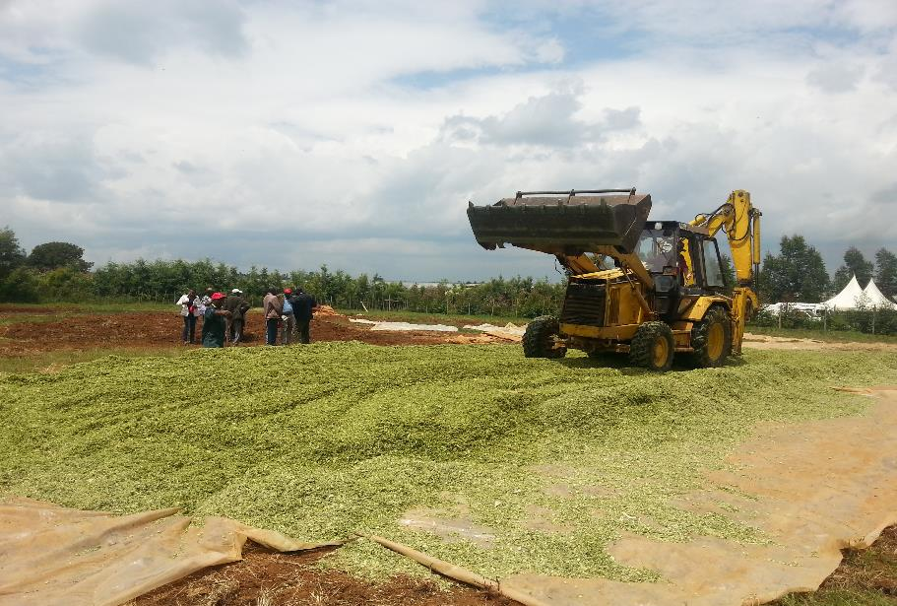
Compaction
Shovel

Slide 14
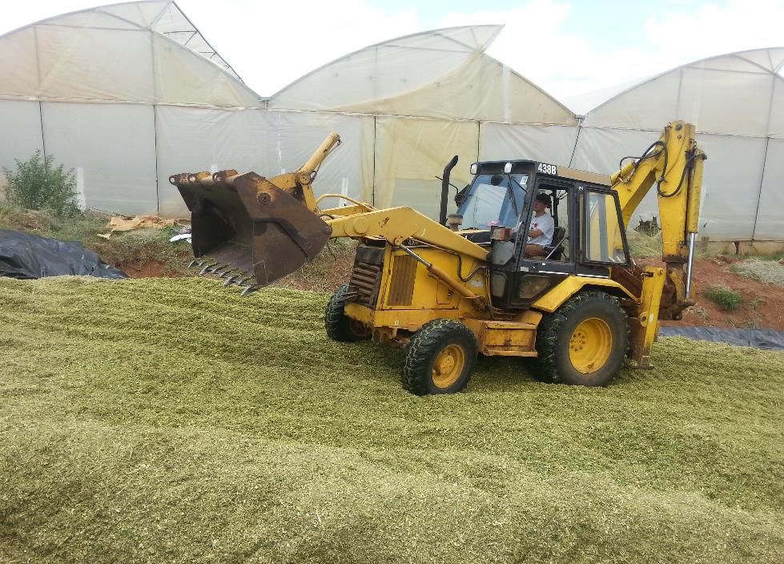

Slide 15
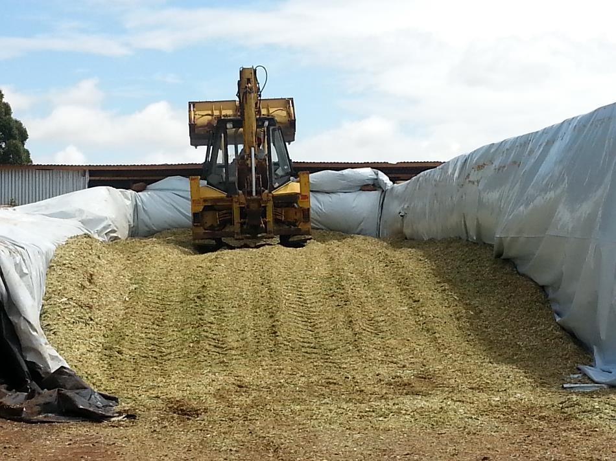

Slide 16
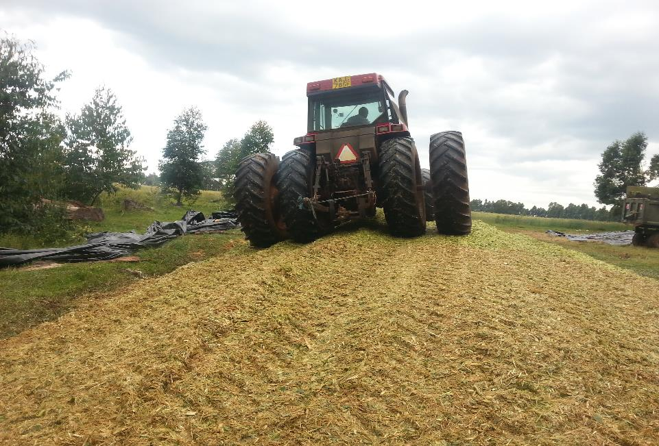
Using a heavy tractor

Slide 17
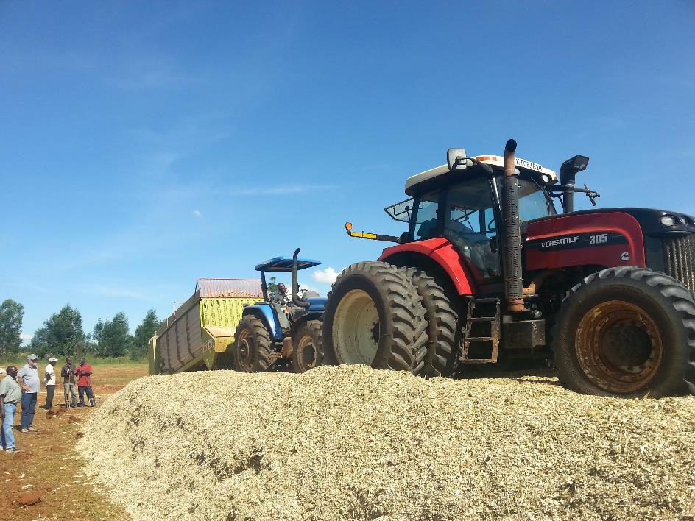

Slide 18
Proper pit/clam dimensions and covering
Feeding speed is calculated based on livestock units to be fed/day
The feeding speed should be at least 1.5 meter per week
The rule of thumb is the narrower the better

Slide 19
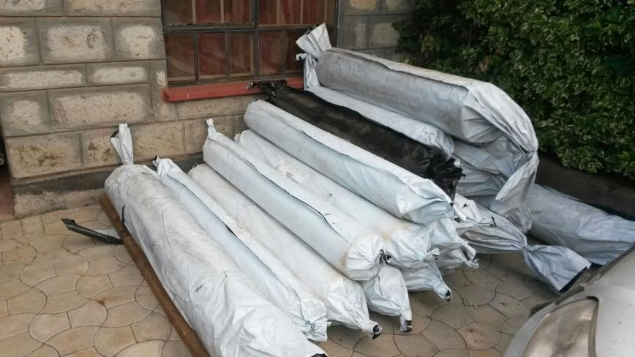
Special manufactured plastic sheeting for fodder silages
Wide enough to cover whole pit at once
UV tolerant
Thick gauge
Nundoroto and Dejirene supply the right plastic sheeting

Slide 20
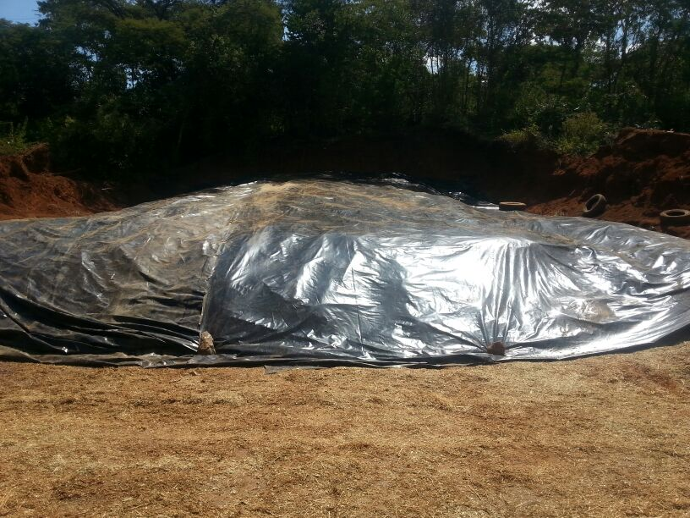
……covering
Pit not airtight !!

Slide 21
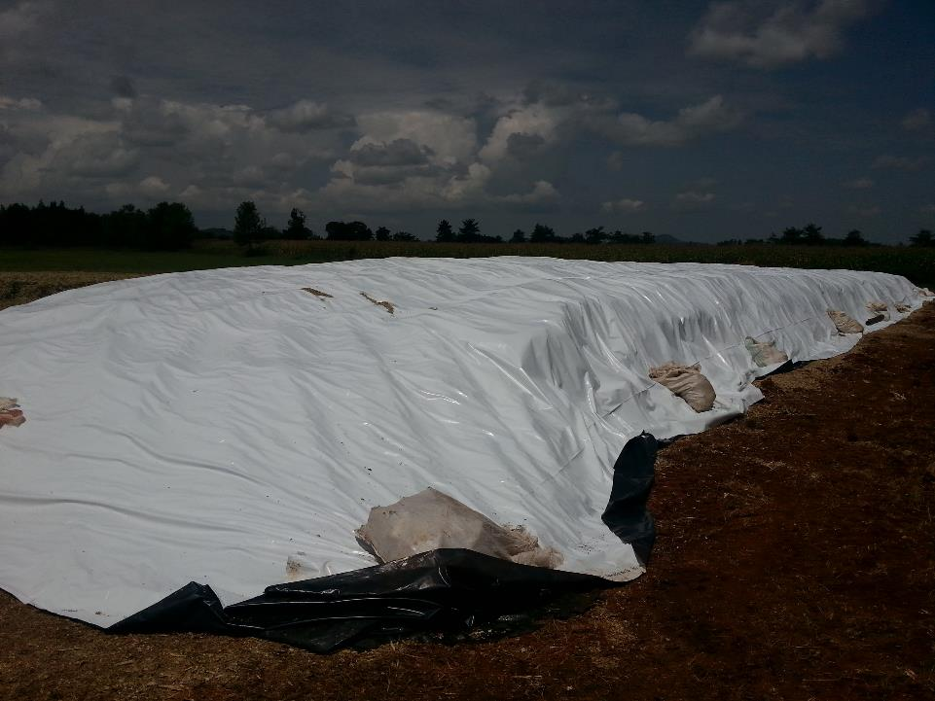

Slide 22
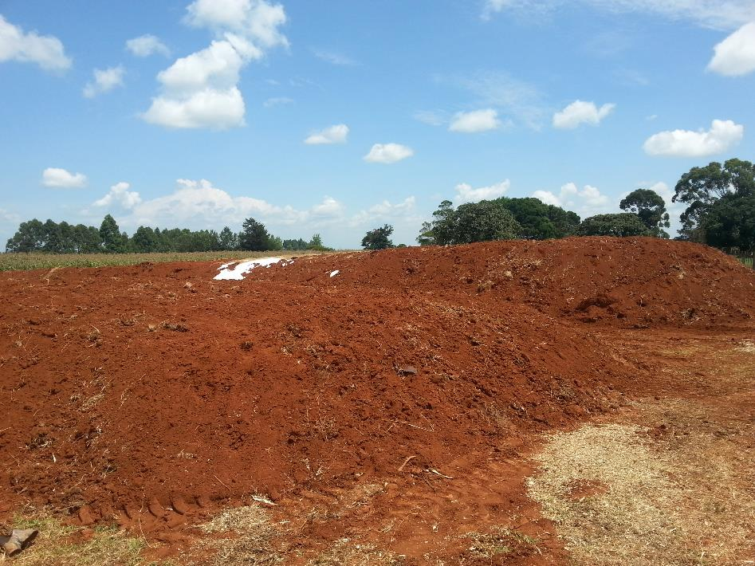

Slide 23
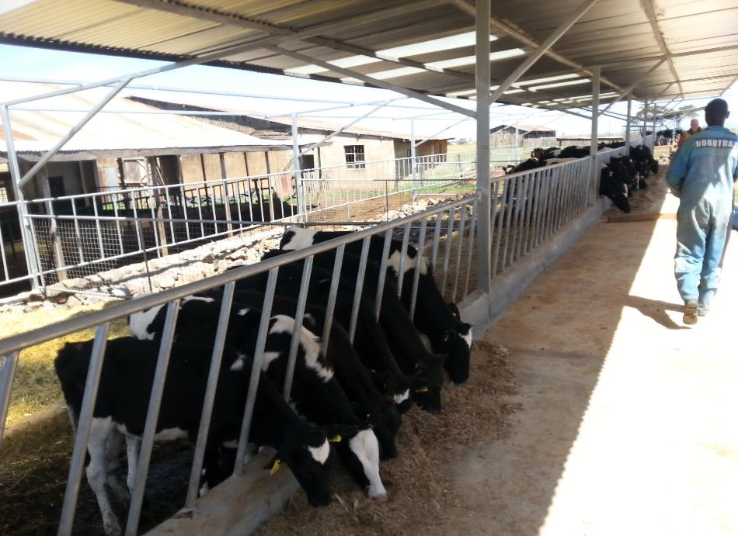

Slide 24
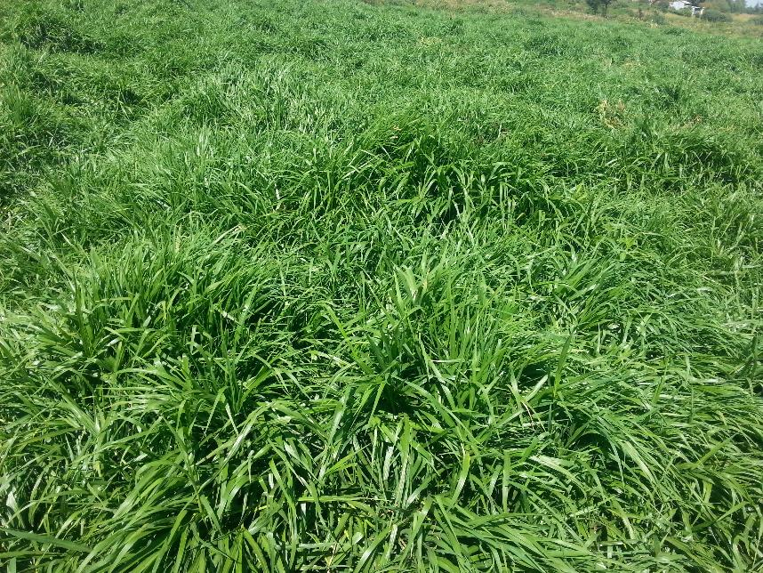
GRASS TRAIN

Slide 25


Slide 26
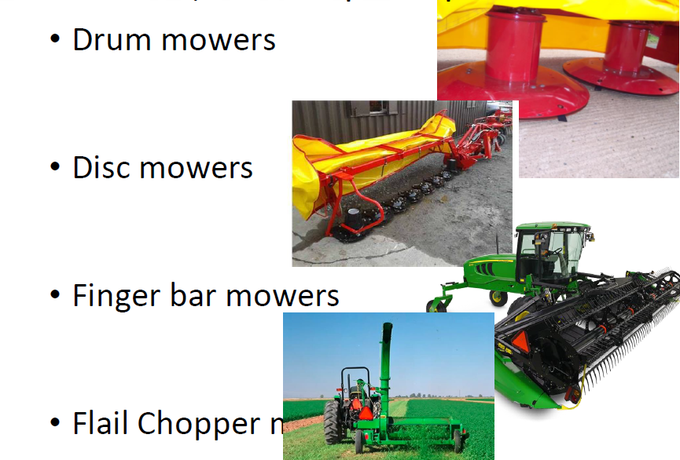
Mowing

Slide 27
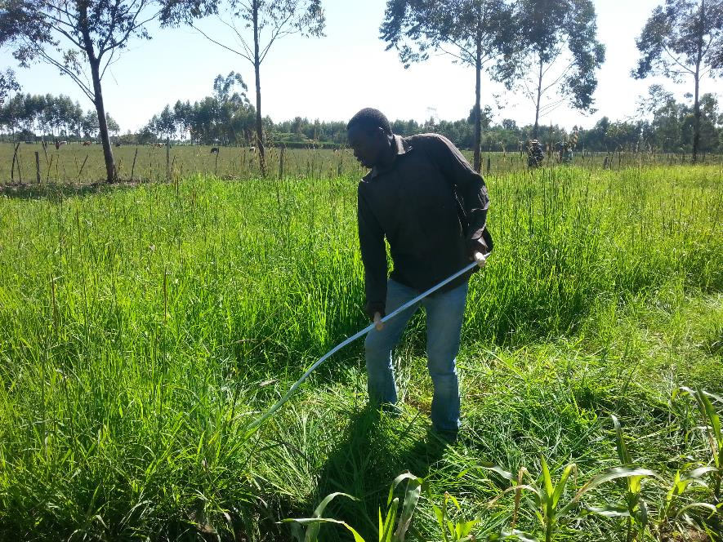
Mowing for small scale farmers using Scythe

Slide 28
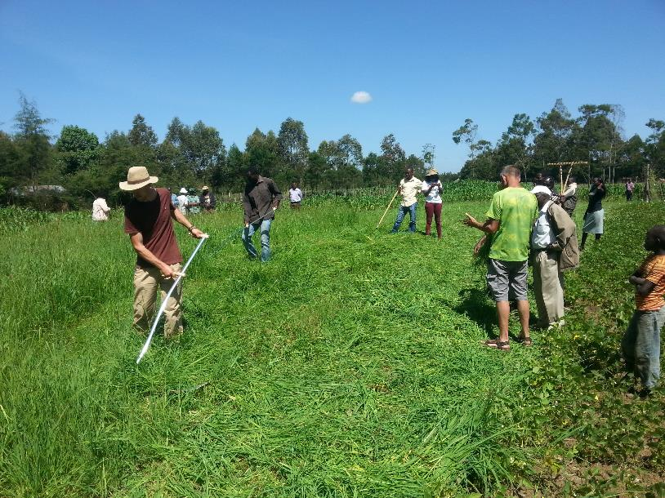

Slide 29
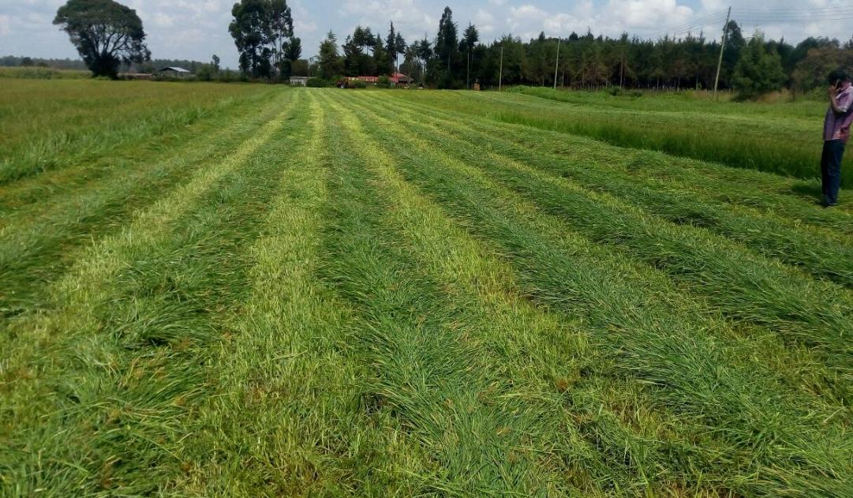
Machine mowing at Willens Farm

Slide 30
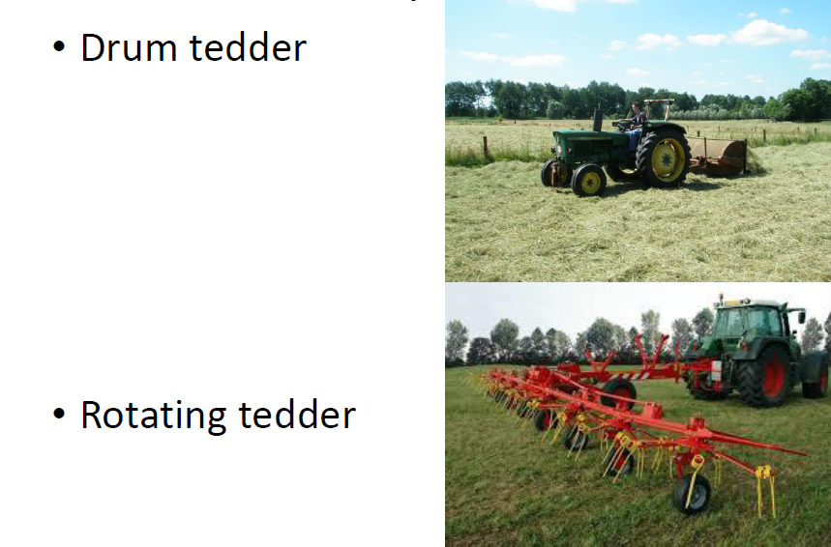
Tedding
To uniformly pre-wilt the grass to 45% Dry Matter within the shortest time

Slide 31
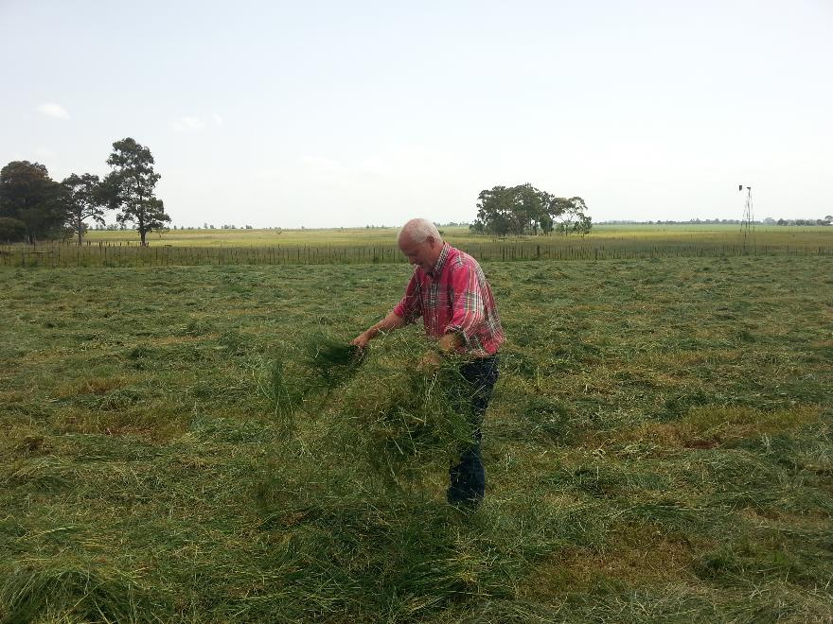
Manual tedding at Samo farm

Slide 32
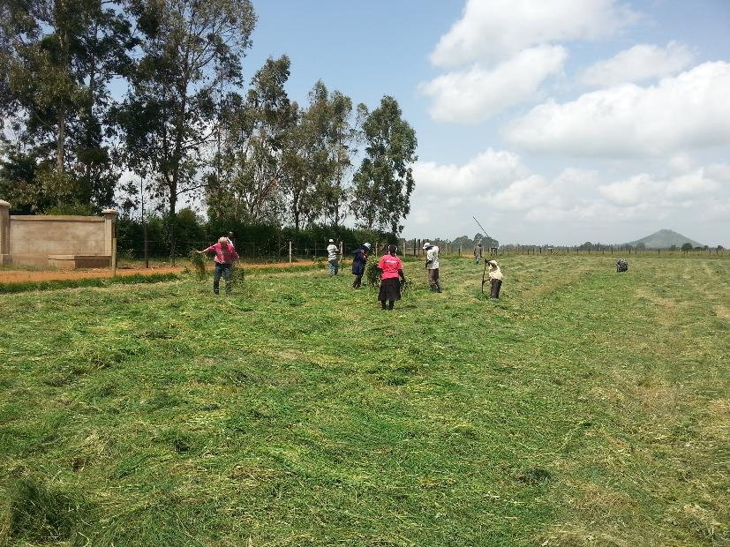

Slide 33
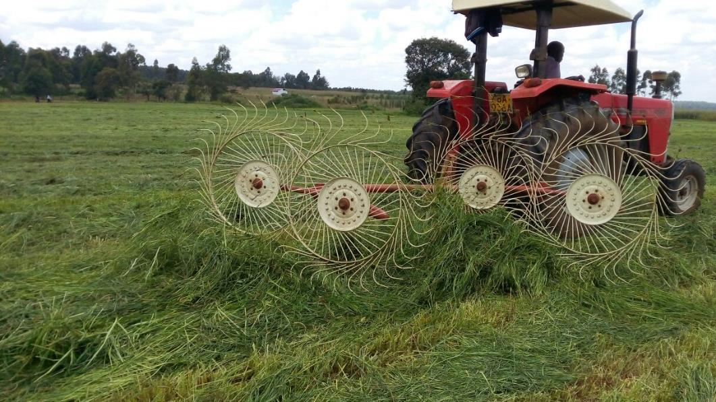
Raking

Slide 34
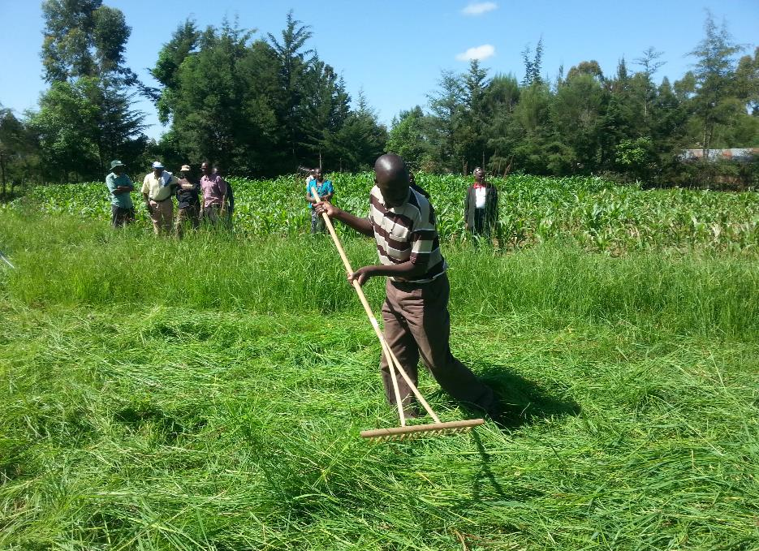
Manual raking

Slide 35
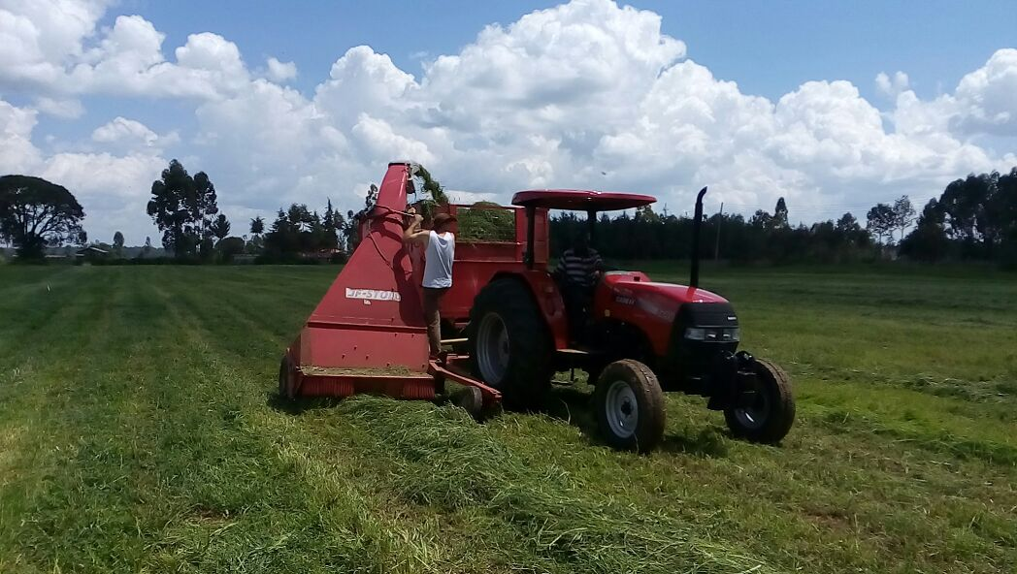
Picking and conditioning grass - Use of Taarup at Willens farm

Slide 36
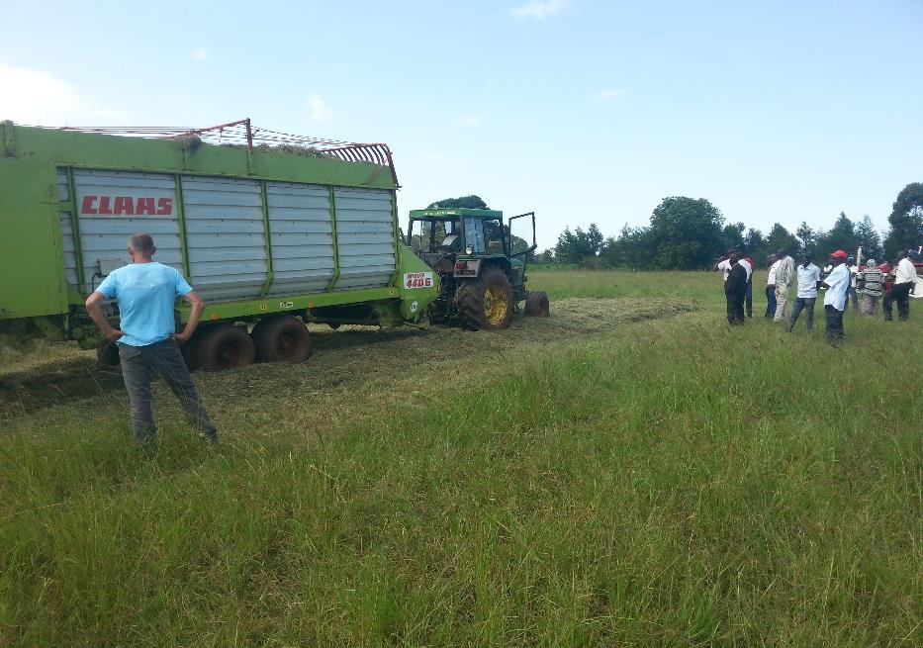
Self-loader from Dejirene

Slide 37
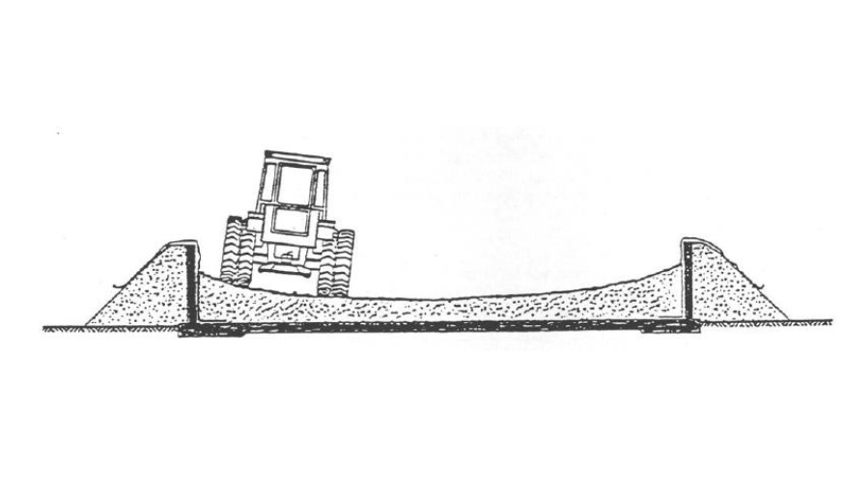
Compaction Procedure

Slide 38
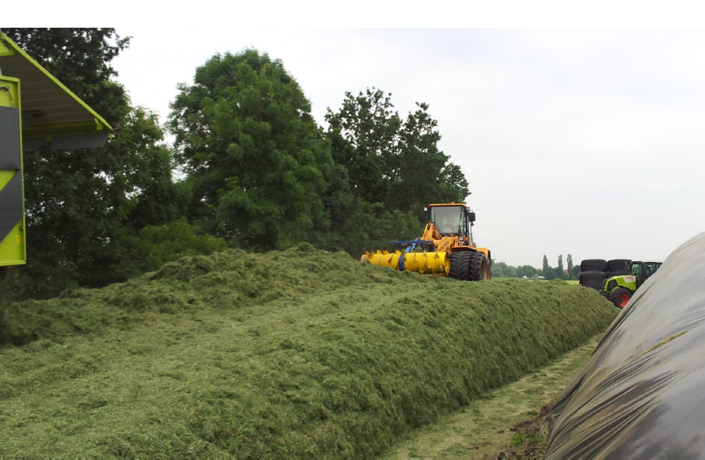

Slide 39
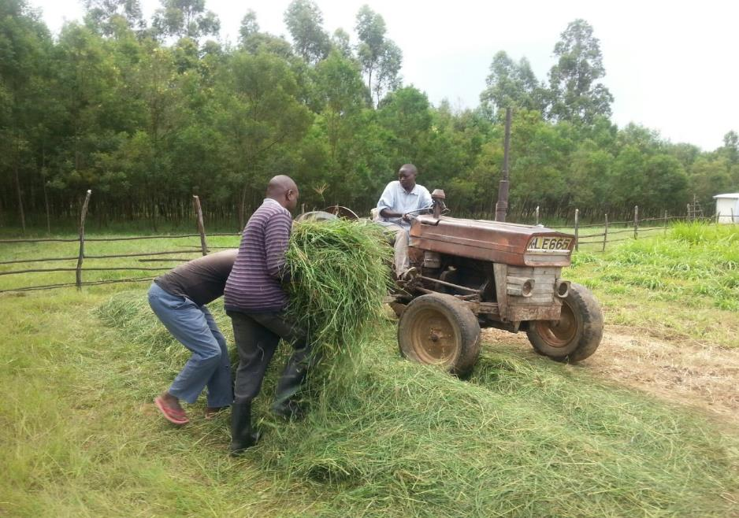
Small scale compaction and covering

Slide 40
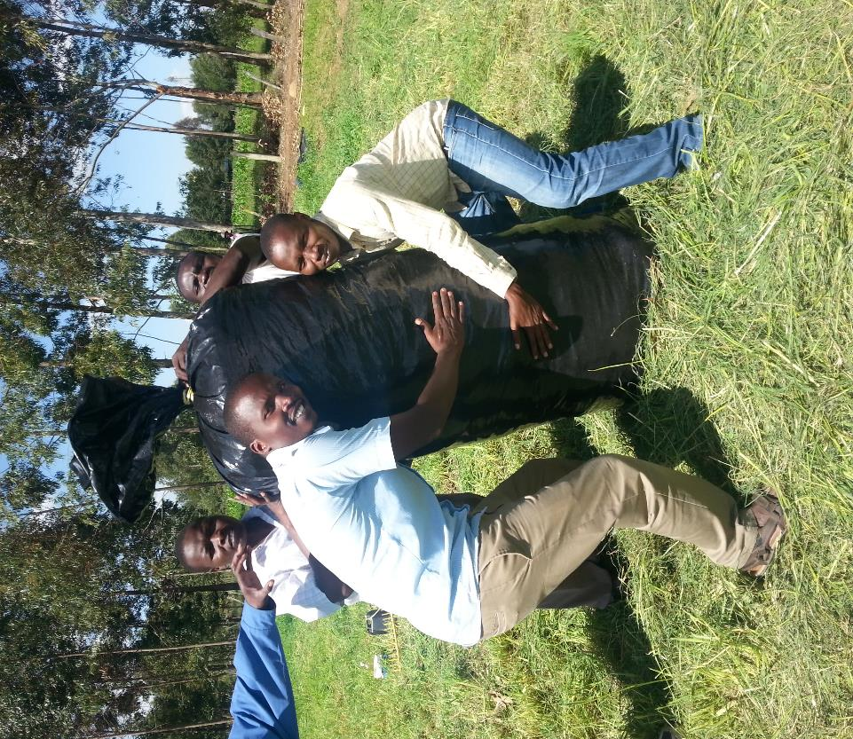
Tube grass silage for small scale

Slide 41
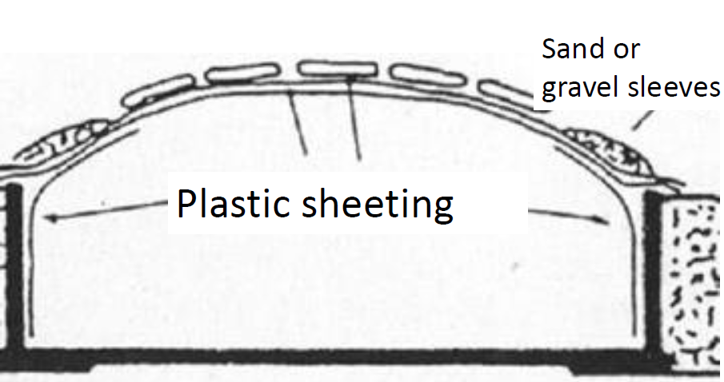
Covering

Slide 42
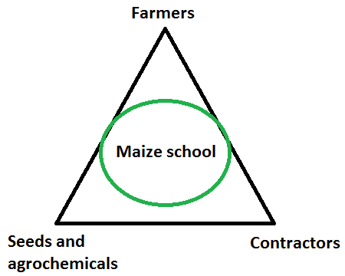
Service model - Dejirene & Nundoroto

Slide 43
THANK YOU

